Slide 1

24CSA449_Artificial Intelligence
Lecture II: Machine Learning Fundamentals

Slide 2
Machine Learning is a concept which allows the machine to learn from examples and experience, and that too without being explicitly programmed.
It is the subset of AI.
A field of AI that uses statistical techniques and algorithms to enable computer systems to recognize patterns in data, make predictions, classify information, and automate decision-making based on the learned patterns and insights.
What is Machine Learning?

Slide 3
"A computer program is said to learn from experience E with respect to some class of tasks T and performance measure P, if its performance at tasks in T, as measured by P, improves with experience"
Task (T): The specific problem the computer is trying to solve (e.g., classifying emails as spam,predicting housing prices, translating languages).
Experience (E): The historical data provided to the algorithm to learn from.
Performance (P): A quantifiable metric used to evaluate how well the system completes the task(e.g., prediction accuracy or error rate)
Definition by Tom Mitchell in 1997

Slide 4
In Machine Learning (ML), data refers to the collection of facts, observations,or measurements that are used to train, test, and evaluate a machine learning model so that it can learn patterns and make predictions or decisions.
Data

Slide 5
Based on Structure: Structured, Unstructured and Semi Structured
Based on Representation: Numerical, Categorical and Ordinal
Based on Labelling: Labelled and Unlabelled
Types of Data

Slide 6
Structured Data:
Highly organized and stored in predefined formats, such as tables, spreadsheets, and relational databases.
It follows a fixed schema with clear relationships between data points.
Eg: Customer records in an SQL database, financial transactions in spreadsheets, or inventory management systems.
Applications: fraud detection, and business intelligence.
Based on Structure

Slide 7
lacks a predefined format and does not fit neatly into relational databases.
It is typically complex, diverse, and requires advanced preprocessing before use in machinelearning models.
Eg: Images, videos, audio files, emails, and social media posts.
Applications: Sentiment analysis, and speech recognition.
Unstructured Data

Slide 8
Data has some level of organization but does not follow a strict schema like structured data.
It contains tags or metadata that help define relationships.
Eg: JSON and XML files
Applications: Document Classification, web scraping
Semi-Structured Data

Slide 9
Numerical (Quantitative) Data
data consists of measurable or countable values, making it suitable for statistical analysis and machine learning models. It is further divided into:
Discrete Data – Represents countable values with a finite number of possible outcomes.
  Examples: Number of students in a class, website clicks, number of defects in a product.
Continuous Data – Represents measurable values with an infinite range. It includes values with decimal points.
  Examples: Temperature readings, stock prices, blood pressure levels.
Based on Representation

Slide 10
Categorical data consists of labels or categories that classify objects or individuals. It is divided into:
Nominal Data – Categories without any inherent order.
  Examples: Gender (Male/Female), Eye color (Brown, Blue, Green), Car brands (Toyota, Ford, BMW).
Ordinal Data – Categories with a meaningful order or ranking, but without a consistent numerical difference.
  Examples: Customer satisfaction levels (Poor, Average, Good, Excellent), Education levels (High School,Bachelor’s, Master’s, Ph.D.).
Categorical (Qualitative) Data

Slide 11
Labeled Data
Labeled data consists of input features paired with corresponding output labels
This type of data is used for tasks where the relationship between input and output is well-defined.
Examples: Email classification (Spam or Not Spam), Image recognition (Identifying cats vs.dogs).
Applications: Used in classification, regression, and NLP models.
Based on Labelling

Slide 12
Data contains only input features without predefined labels, requiring models to identify patternsand relationships on their own.
Examples:
  Customer segmentation based on purchase behavior.
  Clustering social media trends.
Applications: Used in clustering, anomaly detection, and dimensionality reduction.
Unlabeled Data

Slide 13
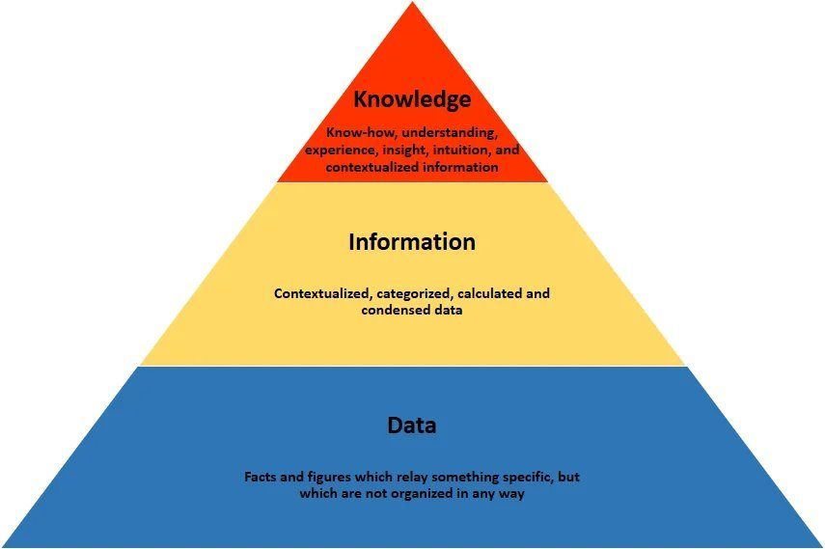
Insightsfrom data

Slide 14
Supervised Learning
Unsupervised Learning
Types of learning

Slide 15
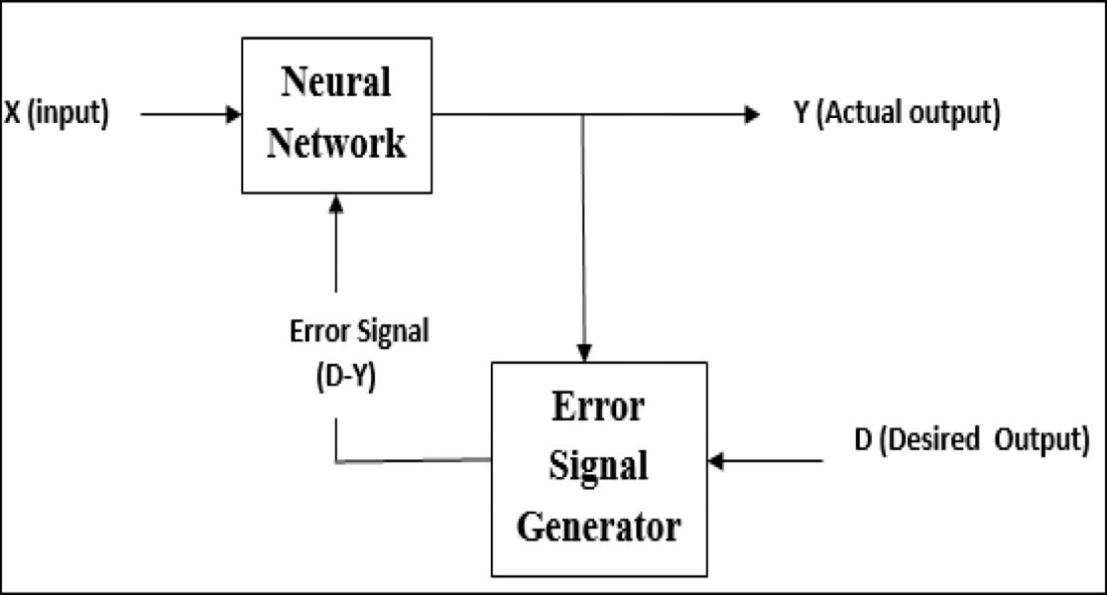
The technique that uses labeled data sets to train the models to identify the underlying patterns and relationships.
It learns the relationship between features and target from the input data.
Types: Classification and regression
Supervised Learning

Slide 16
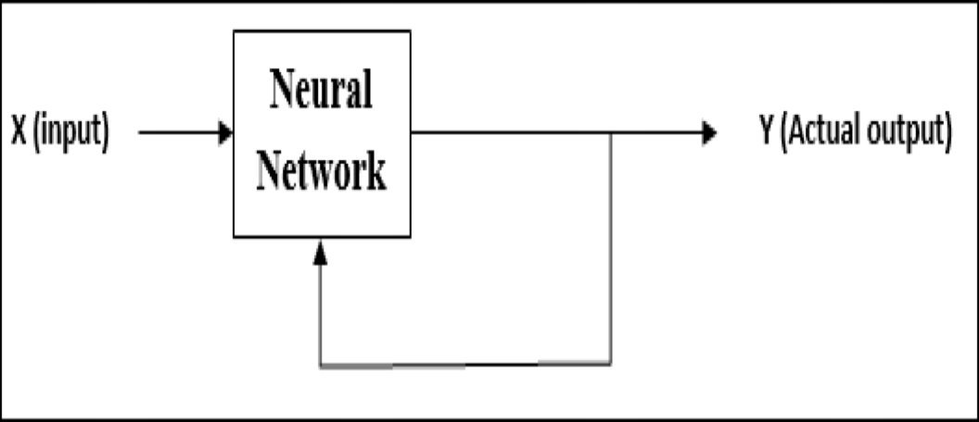
The algorithms that analyze and cluster unlabeled dataset.
There is no feedback from the environment as to what should be the desired output and if it is correct or incorrect. Hence, in this type of learning, the network itself must discover the patterns and features from the input data, and the relation for the input data over the output.
Approaches: Clustering, association and dimensionality reduction
Unsupervised Learning

Slide 17
A learning system in machine learning refers to a structured framework that enables machines to learn from data, recognize patterns, and make informed decisions with minimal human guidance.
These systems are at the core of artificial intelligence, allowing models to adapt and improve as they process more data.
Learning Systems

Slide 18
Data Input: The raw or processed data supplied to the system forms the basis for model training. Both the quality and the volume of this data play a crucial role in determining the overall performance of the system.
Learning Algorithm: This is the central component that governs the learning process. Algorithms such as Linear Regression, Neural Networks, and Decision Trees are designed to address specific problem types and to optimize the model’s performance.
Model Output: Once training is complete, the system produces outputs in the form of predictions, classifications, or recommendations derived from the input data. These outputs are progressively improved through repeated learning cycles. Metrics to improve learning quality
Feedback Mechanism: This essential component supports continuous improvement by comparing predicted outcomes with actual results. The feedback enables the system to adjust its parameters and minimize errors, allowing the model to learn and adapt over time.
Components of learning systems

Slide 19
The development of a machine learning system is a systematic and iterative process that involve several well-defined stages.
Steps involved in the development of a machine learning system are:
1. Defining the problems and objectives
2. Data Collection and Preparation
3. Choosing the Training Experience
4. Selecting the Target Function
Steps in developing the system

Slide 20
5. Choosing a Representation for the Target Function
6. Selecting a Function Approximation Algorithm
7. Training the Model
8. Evaluating Model Performance
9. Iterative Refinement

Slide 21
The foundation of a learning system begins with a clear problem definition
Identifying the type of task the system aims to solve, such as classification (e.g., predicting whether an email is spam), regression (e.g., forecasting sales figures), or clustering (e.g.,customer segmentation).
define measurable performance objectives using metrics like accuracy, precision, recall, orF1-score
1. Defining the problems and objectives

Slide 22
Collecting and preprocessing high-quality, relevant data is critical for the system’s success.
data collection must focus not only on quantity but also on accuracy, consistency, and relevance
Sources of data: databases, sensors, web sources, surveys and forms
Data Gathering: Data can come from different sources
Importance of data quality
Data Preprocessing: The process of transforming raw data into a clean and usable format suitable for machine learning algorithms. Data cleaning techniques, handling missing values, normalization/encoding
2. Data Collection and Preparation

Slide 23
Decide on the type of training experience based on the problem and the nature of the data:
It refers to deciding what data and experiences the learning algorithm will use to learn a task.
Supervised Learning: Best for tasks where labeled data is available, such as predicting loan defaults.
Unsupervised Learning: Suitable for uncovering hidden patterns in unlabeled data, such as clustering customers.
Reinforcement Learning: Ideal for dynamic environments like robotics or gaming, where the system learns through trial and error.
3. Choosing the Training Experience

Slide 24
The target function defines the relationship between inputs (features) and desired outputs(predictions).
Clearly defining this function ensures the algorithm focuses on the right outcomes during training.
Eg: loan approval----> reject/accept
4. Selecting the Target Function

Slide 25
Choosing the appropriate representation for the target function depends on the problem’s complexity and data characteristics:
It determines how the system represents learned knowledge and how accurately it can generalize to unseen data.
Decision Trees: Effective for hierarchical decision-making tasks.
Neural Networks: Suitable for handling non-linear relationships in large, complex datasets.
Linear Models: Best for interpretable, straightforward problems.
This step requires balancing model complexity with interpretability and computational efficiency.
5. Choosing a Representation for the TargetFunction(Concept Representation)

Slide 26
A function approximation algorithm is a method used to learn or estimate an unknown target function by finding the best possible function (hypothesis) from a given hypothesis space that maps inputs to outputs.
This ensures Accurate learning of input–output relationships
The chosen algorithm :
Searches the hypothesis space (set of possible functions)
Adjusts model parameters
Minimizes error or maximizes performance
Algorithms: Gradient descent, Backpropagation, Least Square Method...
6. Selecting a Function Approximation Algorithm

Slide 27
Train the chosen model using the prepared data
Iteratively feeding the data into the algorithm.
Adjusting model parameters to minimize errors using techniques like backpropagation in neural networks.
Monitoring the training process to avoid issues like overfitting, which occurs when the model performs well on training data but poorly on unseen data.
7. Training the Model

Slide 28
Evaluating the model ensures it generalizes well to new data
Validation is the process of assessing the model's performance during development and tuning
Common evaluation methods include:
  Hold-out validation
  k-fold cross-validation
  Performance metrics such as accuracy, precision, recall, F1-score, and mean squared error
  Evaluation helps in identifying issues such as overfitting or underfitting and supports model refinement and optimization.
8. Evaluating Model Performance

Slide 29
A trial-and-improvement cycle.
Iterative refinement helps improve the model's accuracy, robustness, and generalization.
9. Iterative Refinement

Slide 30
What kinds of problems do we solve using these learning approaches?

Slide 31
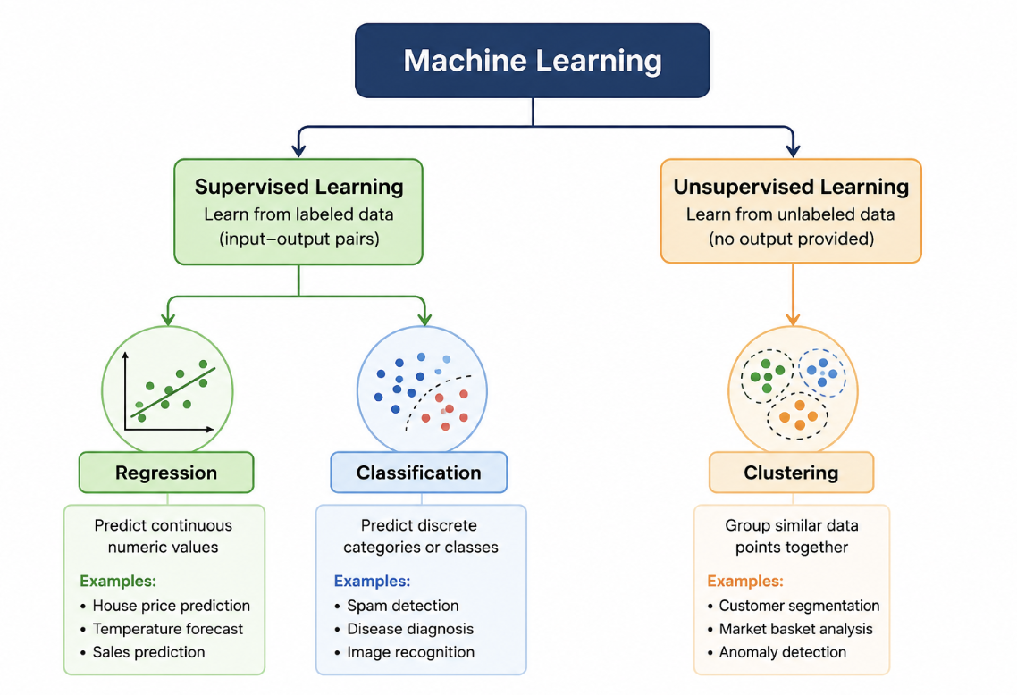
ML Tasks

Slide 32
Linear Regression is a fundamental statistical method used to define linear relationship between a dependent and one or more independent variables.
The most common form of regression analysis is linear regression, in which one finds the line (or a more complex linear combination) that most closely fits the data according to a specific mathematical criterion.
This allows the researcher to estimate the value of the dependent variable when the independent variables take on a given set of values.
Regression

Slide 33
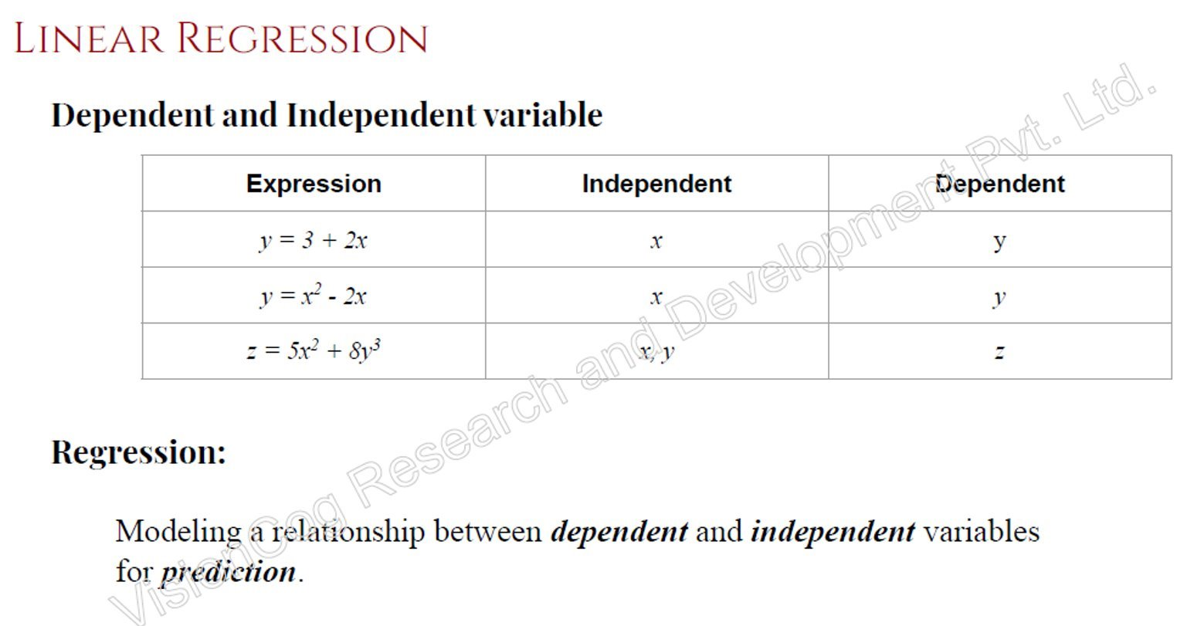

Slide 34
Linear Regression
  Simple Linear Regression or Univariate Linear Regression.
    Only one independent variable
  Multiple Linear Regression or Multivariate Linear Regression.
    More than one independent variable
Non-linear regression
    commonly used for more complicated data sets in which the dependent and independentvariables show a nonlinear relationship

Slide 35
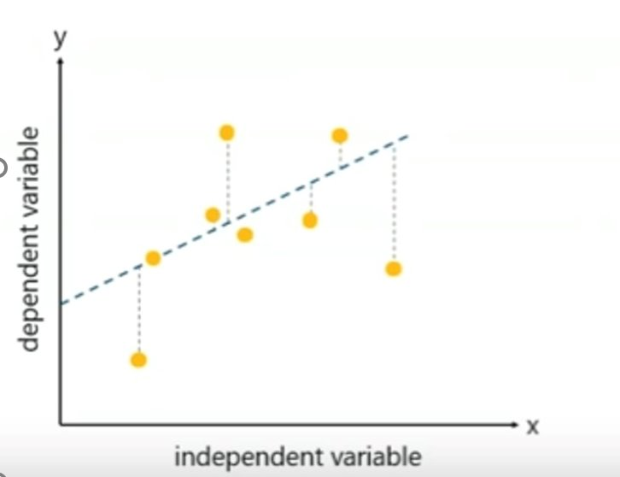
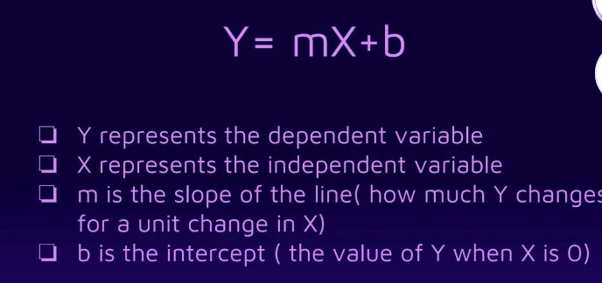
Linear Regression

Slide 36
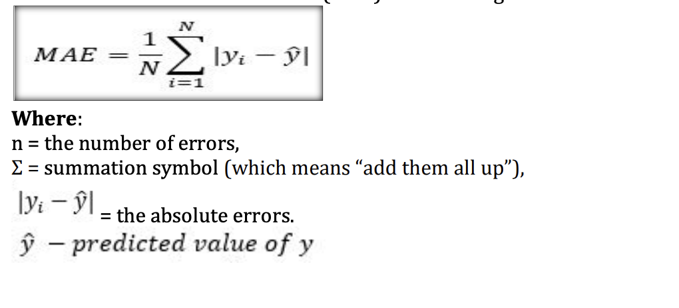
Mean Absolute error (MAE) − It is the average of the absolute difference between predicted values and true values.
Evaluation Metrics for Regression

Slide 37
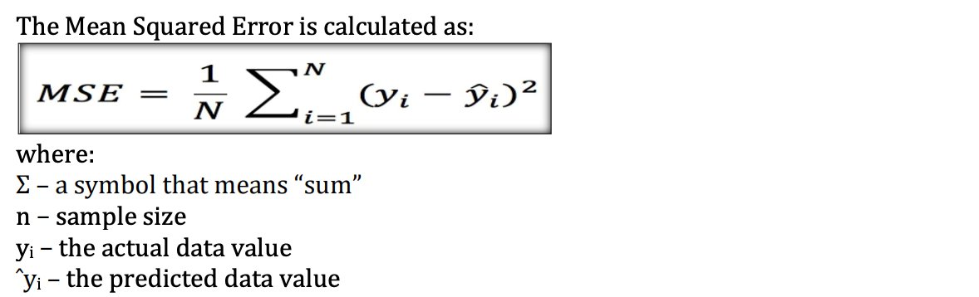
Mean Squared error (MSE) − It is the average of the square of the difference between actual and estimated values.

Slide 38
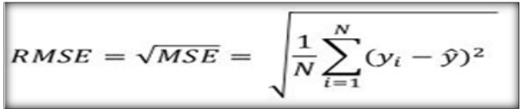
Root mean square error (RMSE) − It is the square root value of the mean squared error (MSE).

Slide 39
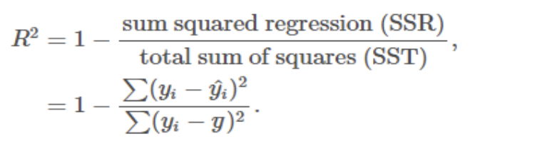
R² (coefficient of determination) Score − the best possible score is 1.0, and it can be negative

Slide 40
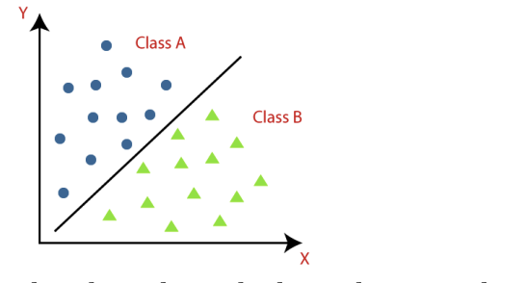
The Classification algorithm is a Supervised Learning technique that is used to identify the category of new observations on the basis of training data.
In Classification, a program learns from the given dataset or observations and then classifies new observation into a number of classes or groups.
Classes can be called as targets/labels or categories
Classification

Slide 41
The algorithm which implements the classification on a dataset is known as a classifier.
There are two types of Classifications:
Binary Classifier: If the classification problem has only two possible outcomes, then it is called as Binary Classifier.
Examples: YES or NO, MALE or FEMALE, SPAM or NOT SPAM, CAT or DOG, etc.

Slide 42
Multi-class Classifier: If a classification problem has more than two outcomes, then it is called as Multi-class Classifier.
Example: Classifications of types of crops, Classification of types of music.
Measuring Classifier Performance The quality is classifier is measured in terms of True Positive, False Positive, True Negative and False Negative, Precision, Recall and F-Measure.

Slide 43
True Positive: - Those instance where predicted class and actual class are both positive are called as true positive or a true positive is an outcome where the model correctly predicts the positive class
For example in case of bird classifier, the birds that are correctly identified as birds are called as true positive.

Slide 44
True Negative: - Those instances where predicted class and actual class are both negative are called as true negative or a true negative is an outcome where the model correctly predicts the negative class.
For example, in case of our bird classifier there are images that are not of birds which our classifier correctly identified as “not a bird” are called as true negatives.

Slide 45
False Positive: - Those instances where predicted class is positive, but actually the instances are negative or a false positive is an outcome where the model incorrectly predicts the positive class.
For example, in case of our bird classifier there are some images that the classifier predicted as birds but they were something else. These are our false positives.

Slide 46
False Negative: -Those instances where predicted class is negative, but actually the instances are positive or a false negative is an outcome where the model incorrectly predicts the negative class.
For example, in case of our bird classifier there are some images of birds that the classifier did not correctly recognize as birds.

Slide 47
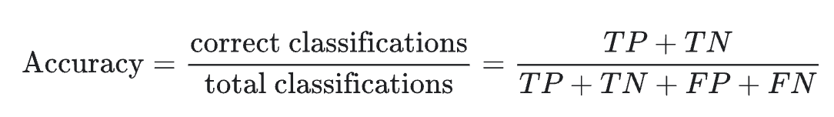
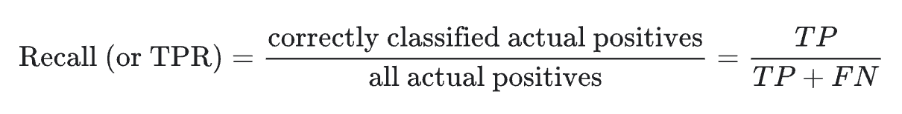
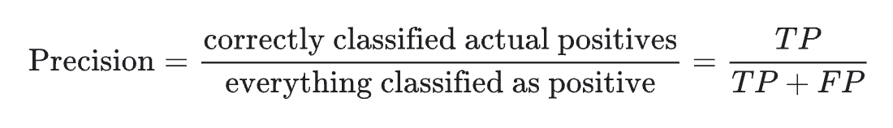
Evaluation measures
F1 Score = 2*(Recall * Precision) / (Recall + Precision)

Slide 48
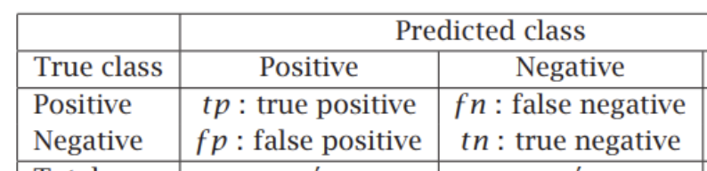
Confusion Matrix: - Confusion matrix is a N×N table that summarizes the accuracy of a classification model’s predictions.
Here, N represents the number of classes.

Slide 49
Clustering is the process of arranging a group of objects in such a manner that the objects in the same group (which is referred to as a cluster) are more similar to each other than to the objects in any other group. it is an iterative process of information discovery that requires domain expertise and human judgment, used frequently to make adjustments to the data and the model parameters to achieve the desired result.
Clustering

Slide 50
How Clustering can be evaluated?
Three important factors by which clustering can be evaluated are
(a) Clustering tendency
(b) Number of clusters, k
(c) Clustering quality

Slide 51
Number of clusters, k
Some of the clustering algorithms like K-means, require number of clusters, k, as clustering parameter.
Getting the optimal number of clusters is very significant in the analysis.
If k is too high, each point will broadly start representing a cluster and if k is too low, then data points are incorrectly clustered.
Optimal number of K can be determined by Elbow method.

Slide 52
Silhouette score
Based on the closeness to other data points in that cluster as well as to data points in other clusters
Silhouette score returns the average silhouette coefficient applied on all the samples.
Two parts:
Cohesion: intra distance--→ take the mean(a)
Separation: inter distance-→ take mean(b)
The formula is as follows:
(b-a)/ max(b,a)
Clustering quality:

Slide 53
The Silhouette Coefficient ranges from [-1,1].
The higher the Silhouette Coefficients (the closer to +1), the more is the separation between clusters.
If the value is 0 it indicates that the sample is on or very close to the decision boundary between two neighboring clusters .
a negative value indicates that those samples might have been assigned to the wrong cluster

